Slide 1
Report Builder
Lecturer: Ngo Huy Bien
Software Engineering Department
Faculty of Information Technology
VNUHCM - University of Science
Ho Chi Minh City, Vietnam
nhbien@fit.hcmus.edu.vn

Slide 2

Objectives
To use Report Builder to create paginated reports.

Slide 3

Contents

Slide 4

References
Brian Larson (2017). Microsoft SQL Server 2016 Reporting Services. McGraw-Hill Education.

Slide 5
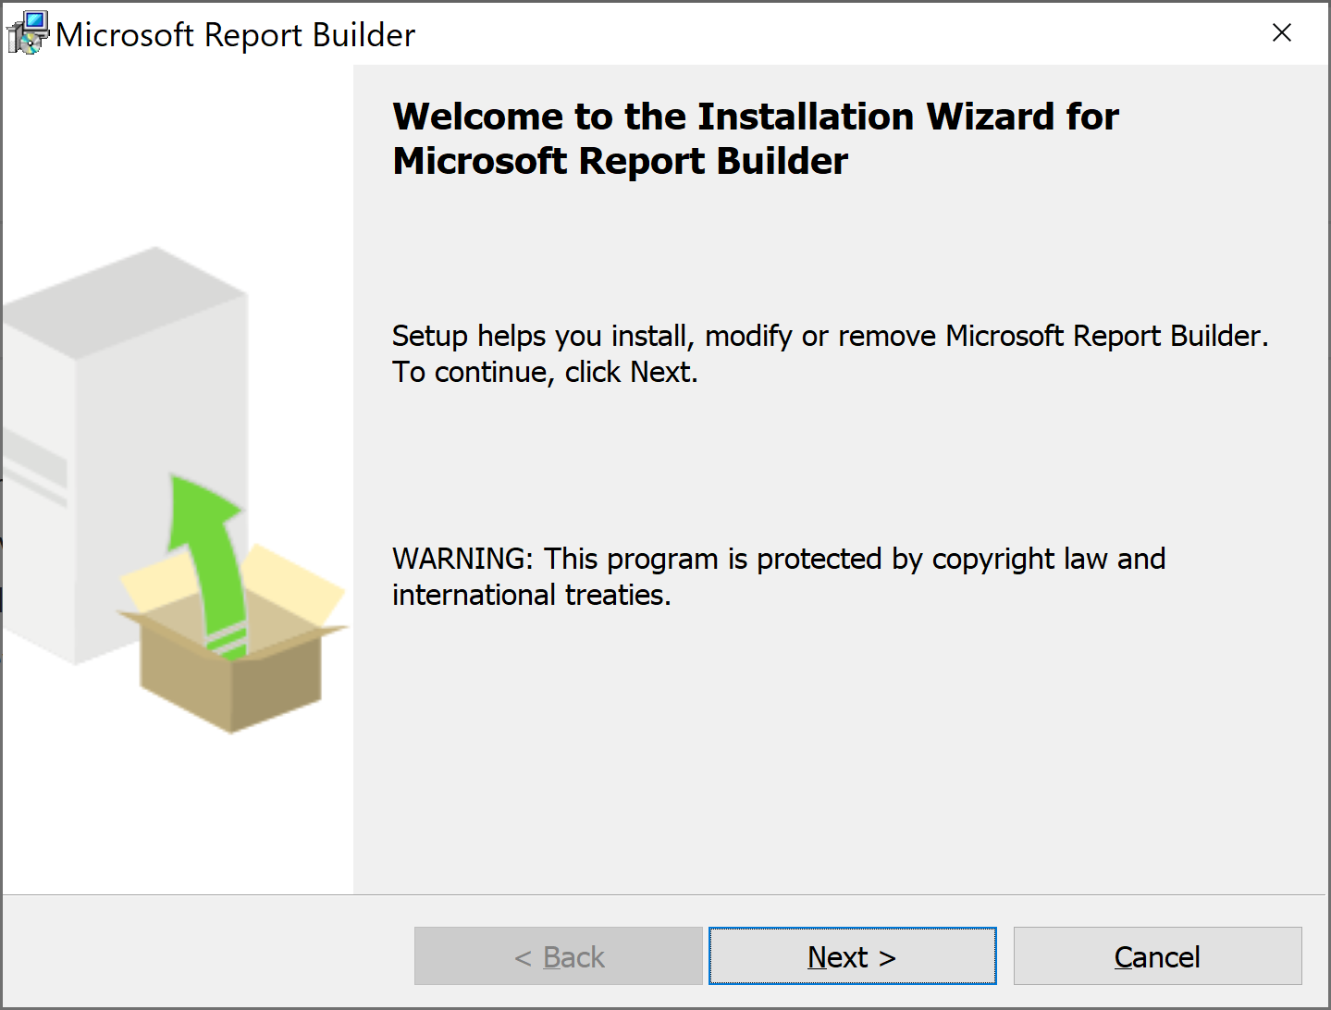
Install Report Builder
https://www.microsoft.com/en-us/download/details.aspx?id=53613

Slide 6
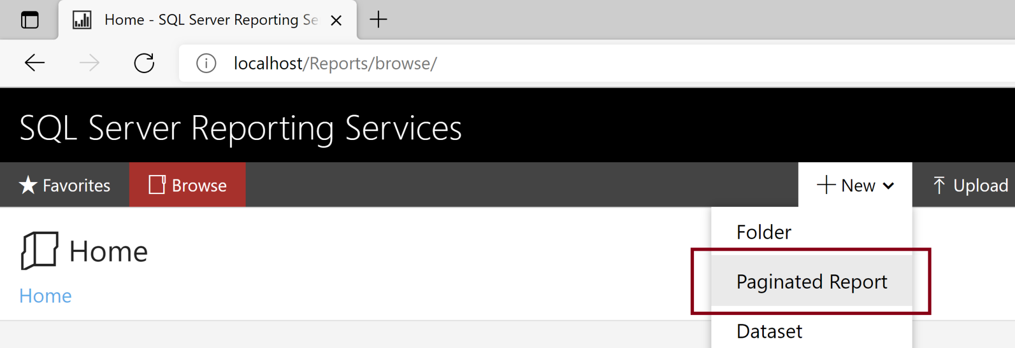
Launch the Report Builder
http://localhost/Reports/browse/

Slide 7
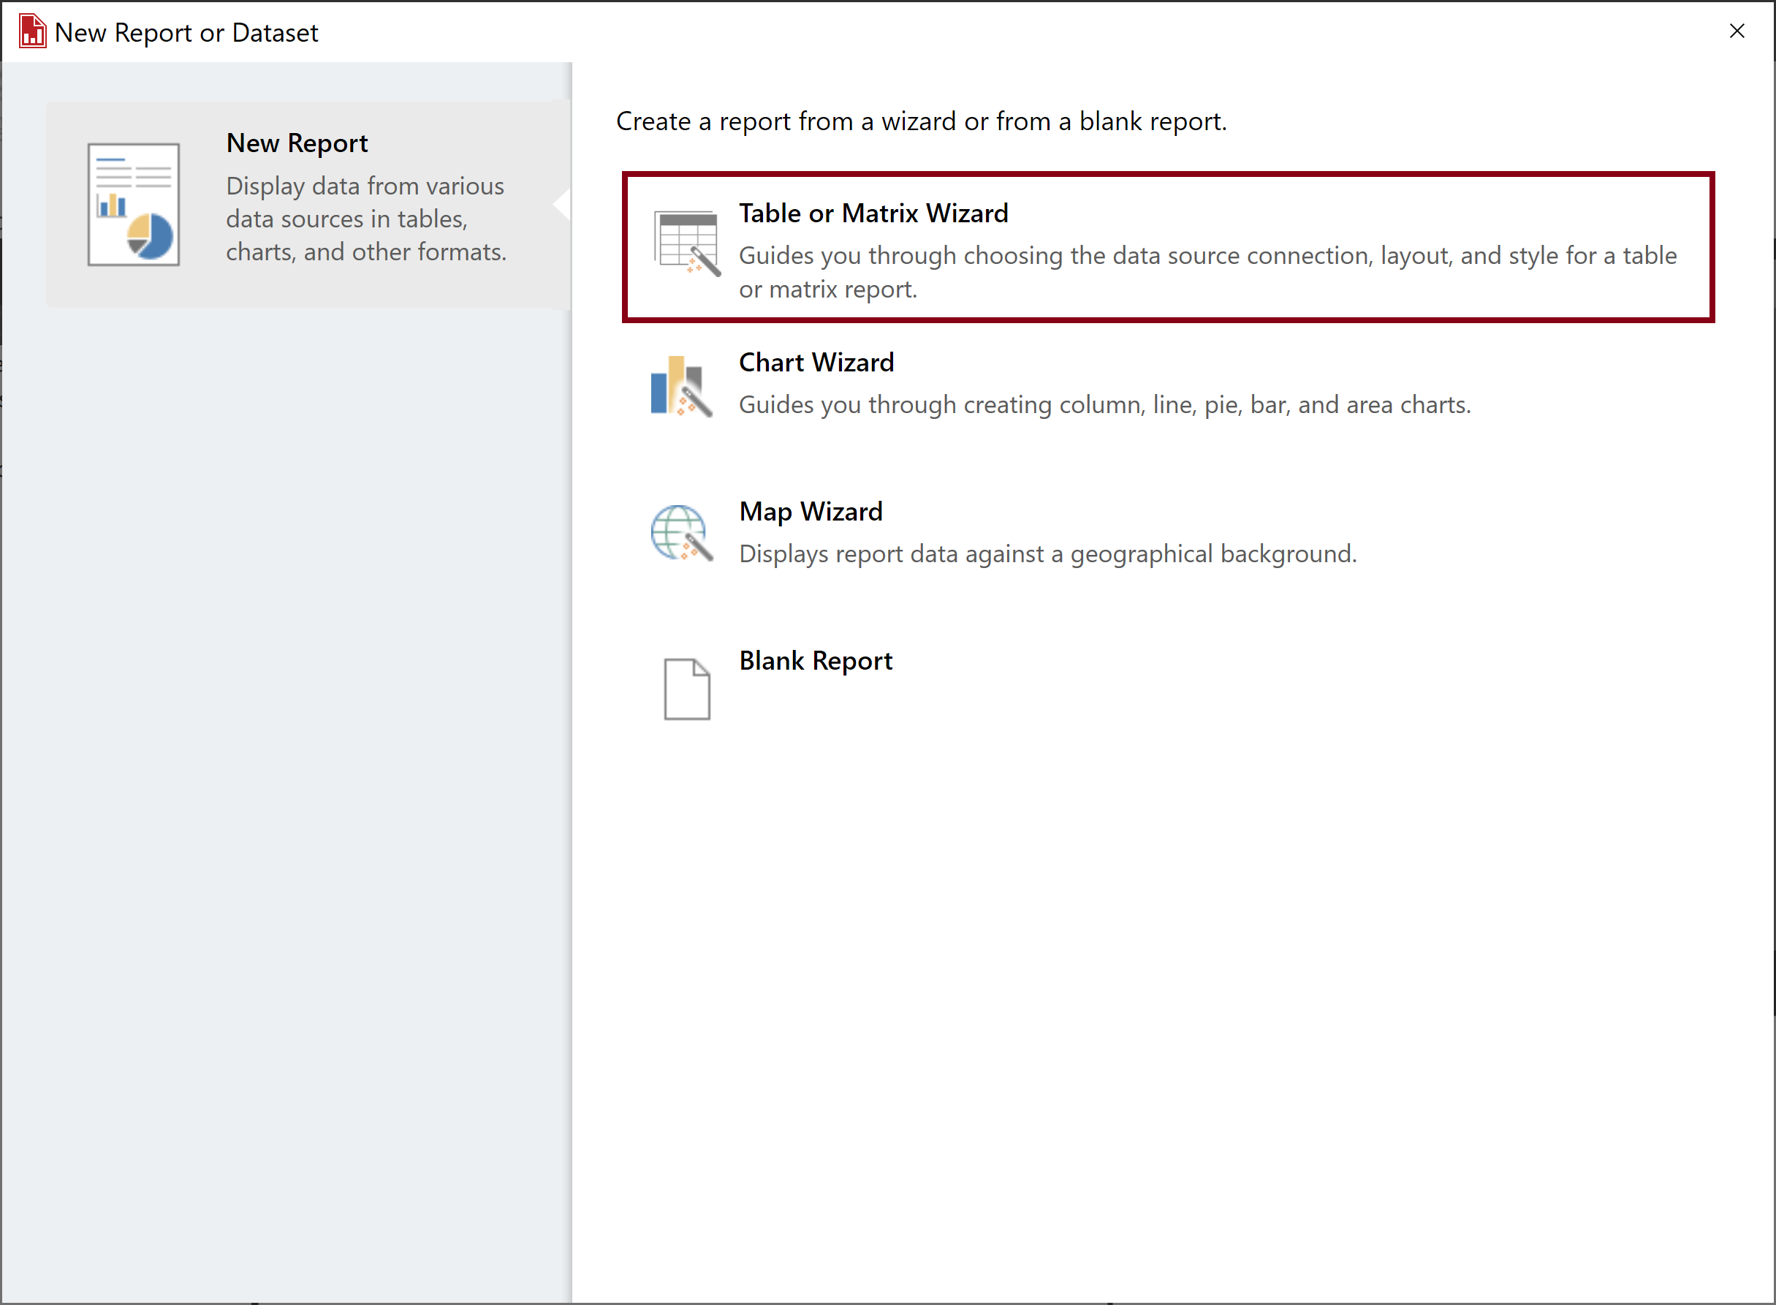
Create a Paginated Report

Slide 8
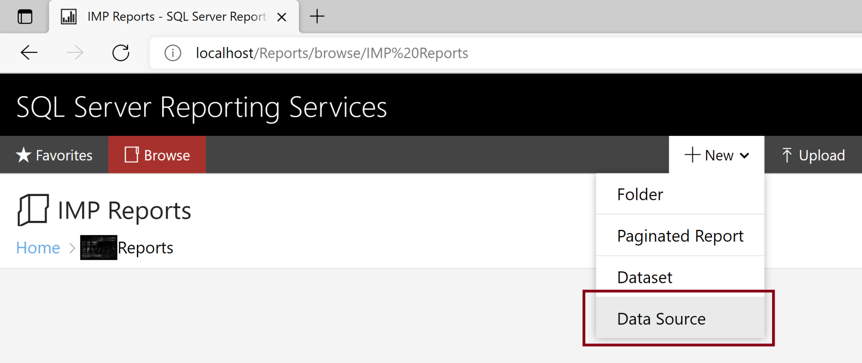
Create a Data Source

Slide 9

Further Reading

Slide 10

Thank You & See You Again

